Slide 1
Digital Vision Screening
Shannon Harris, Arvind Rao, Steven Yuan, David Chan, Brian Nguyen, John Chan, Tianyu(Mark) Ma, Andrew Nguyen, Byung-Chul In (Brian), Si Li, Xiaomeng Wang, Rolando Cheung Wu, Shumin Gao
Notes:
Shannon will speak about this slide

Slide 2


Client Overview: Shiley Eye Center
Notes:
David will speak about this slide and will write that slide

Slide 3

Before This Quarter
Hardware
Drafted prototype ideas
Front-end
Photo upload functions
Page movement functions
Back-end
Eye detection and reset
Pupil detection and reset
Notes:
Arvind will speak about this slide

Slide 4
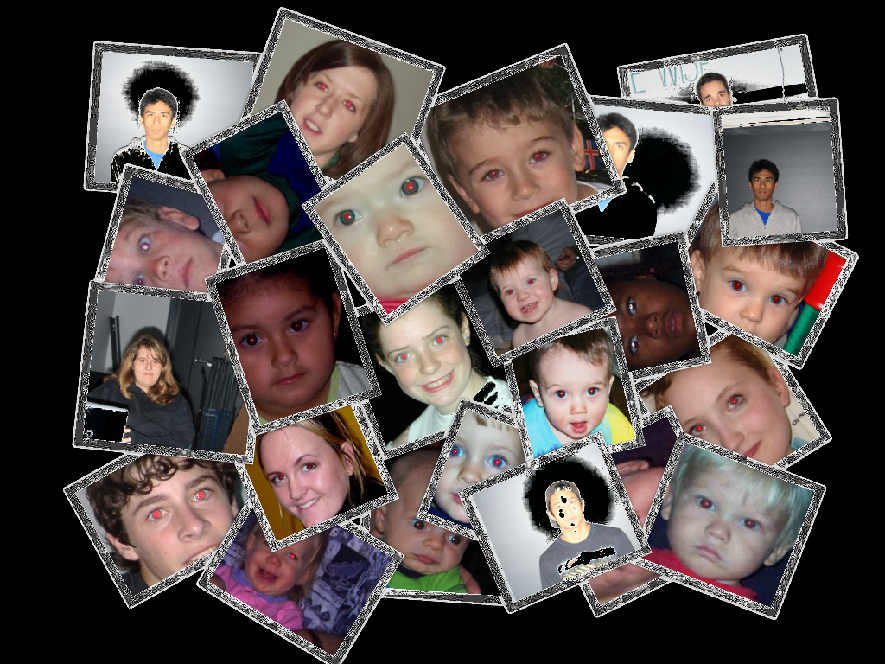
Demo:
Hardware and Software
Notes:
Si will speak about this slide and Andrew will demo the camera/bracket

Slide 5
Hardware progress this quarter
Able to design a new better functioning bracket
Solved the issue of camera and flash rotation using another bracket
Solved red-eye issue taking photos on Asian ethnicity
Notes:
Andrew will speak about this slide

Slide 6
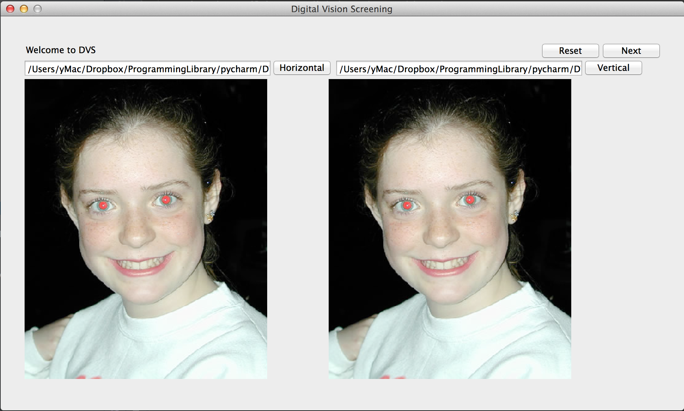
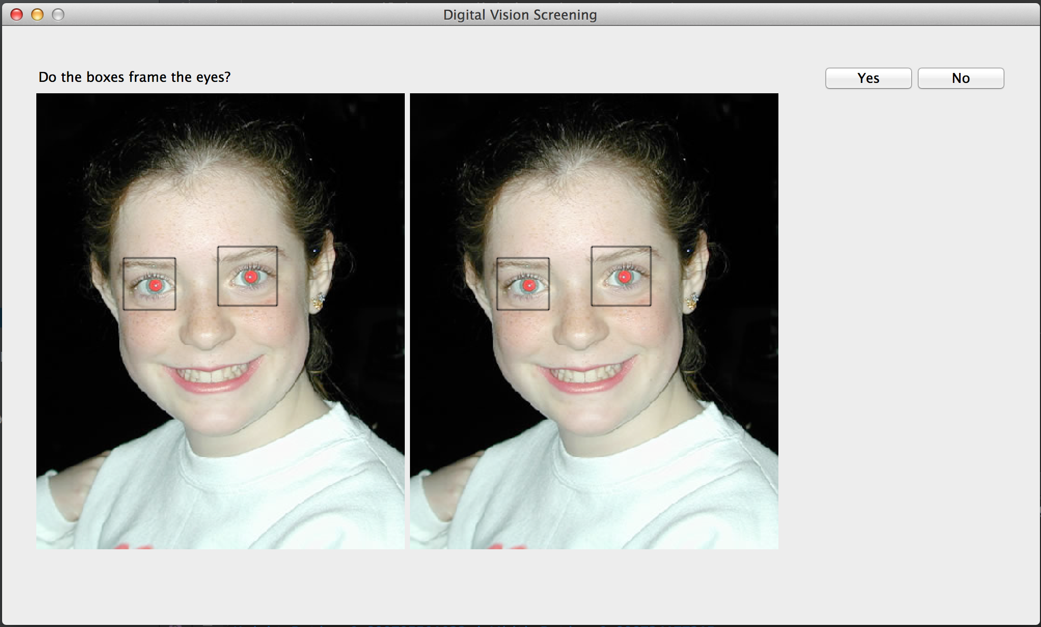
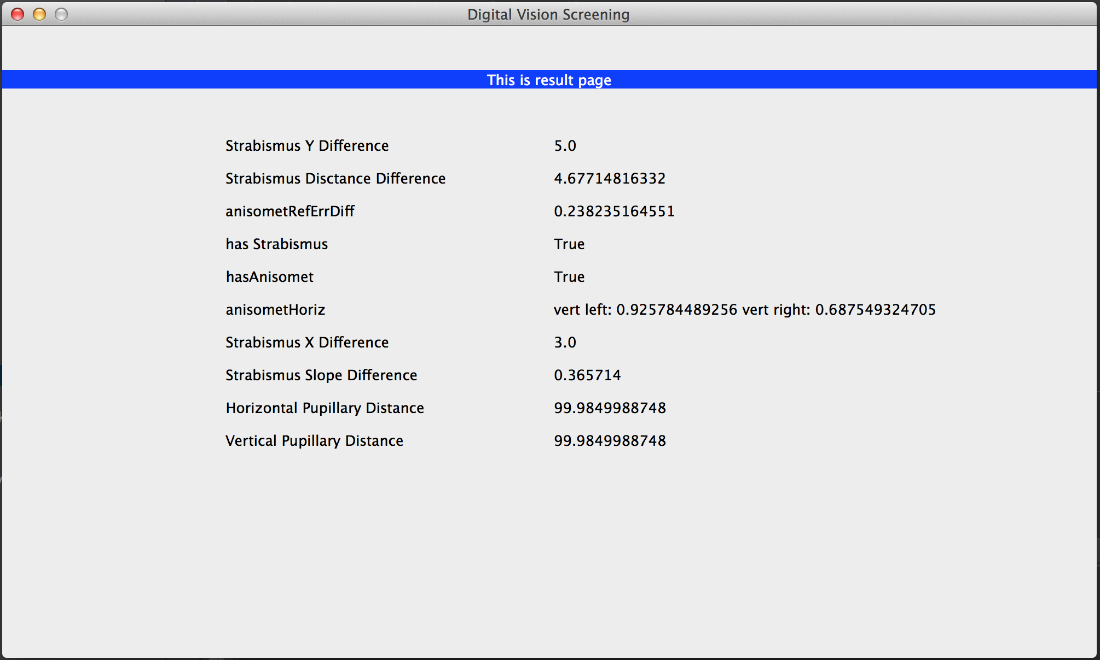
Front End progress this quarter
Showing the user the eye detection results
Allowing the user to correct said results if wrong
Showing the possible diagnosis and referral
Notes:
Rolando will speak about this slide

Slide 7
Backend Progress this quarter
Completed Strabismus/Anisometropia/Astigmatism Detection
Debugged pupil and eye reset code
Wrote pupillary distance algorithm
Completed OOP structure by adding appropriate get() methods
Notes:
Brian will speak about this slide

Slide 8
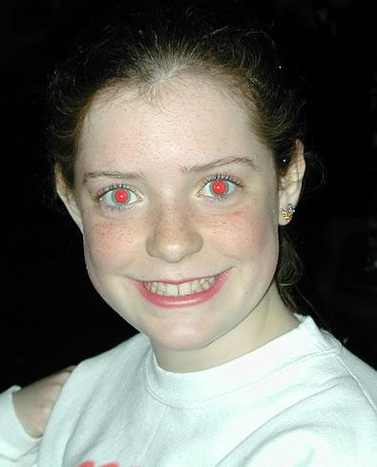
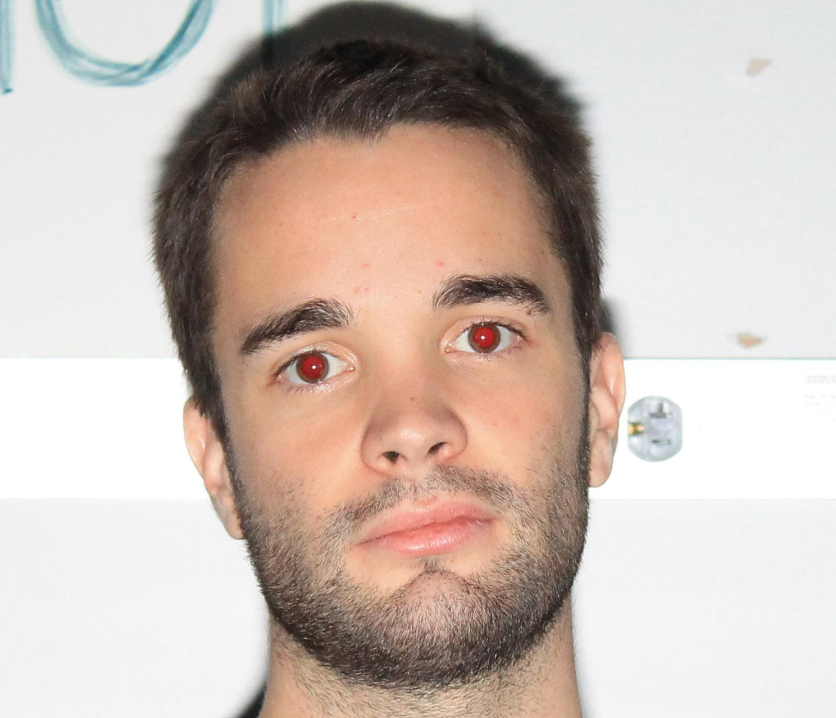
Example of two patients
Notes:
Brian will speak about this slide

Slide 9

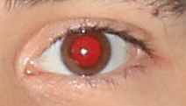
Cropped image of one of their eyes
Patient: Random Patient: JT Brown
Notes:
Brian will speak about this slide

Slide 10








Pupil detection processing
Notes:
Brian will speak about this slide

Slide 11

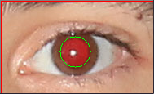
Pupil detection
Incorrect Detection Correct Detection
Random JT Brown
Notes:
Brian will speak about this slide

Slide 12
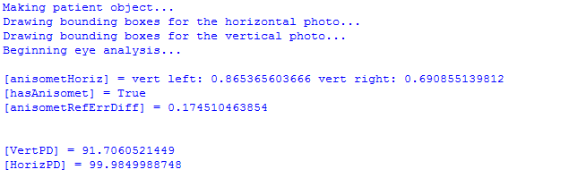
Sample results from image analysis
Notes:
Brian will speak about this slide

Slide 13

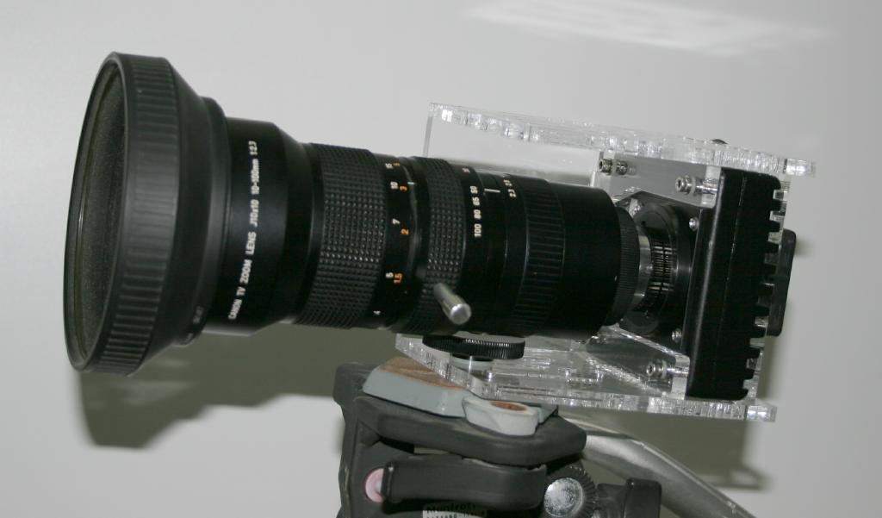
Future Goals
Software
Front-end
UI polish
More functionalities
Back-end
Code optimization & implementation
Testing on more photos
Hardware
Camera mounter
Producing desired photos
Client Feedback/Bug Fixes
Notes:
Shannon will speak about this slide

Slide 14

Questions?
Notes:
Everybody will speak about this slide

